Slide 1

Testing, Debugging, Optimization, Security
in Javascript
By Tanvi Sharma

Slide 2
Agenda
Testing
Debugging
Optimization
Security

Slide 3


Slide 4




Testing in Javascript
What is Testing?
The process of running code to check if it produces the expected results.
Types of Testing in JavaScript:
Unit Testing
Integration Testing
End-to-End Testing
Testing Tools:
Jest
Mocha
Jasmine
Chai
(People in testing like beverages!)

Slide 5
Unit Testing with Jest in JS
Why Use Jest?
Easy to use, comes with built-in assertions.
Supports mock functions.
Example- Simple unit test with Jest: function add(a, b) {
return a + b;
}
test('adds 1 + 2 to equal 3', () => {
expect(add(1, 2)).toBe(3);
});

Slide 6
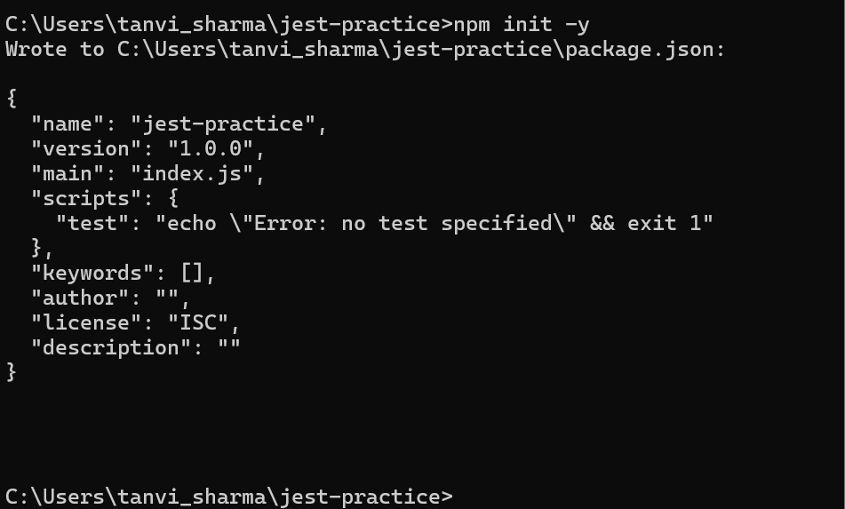
Jest Setup

Slide 7
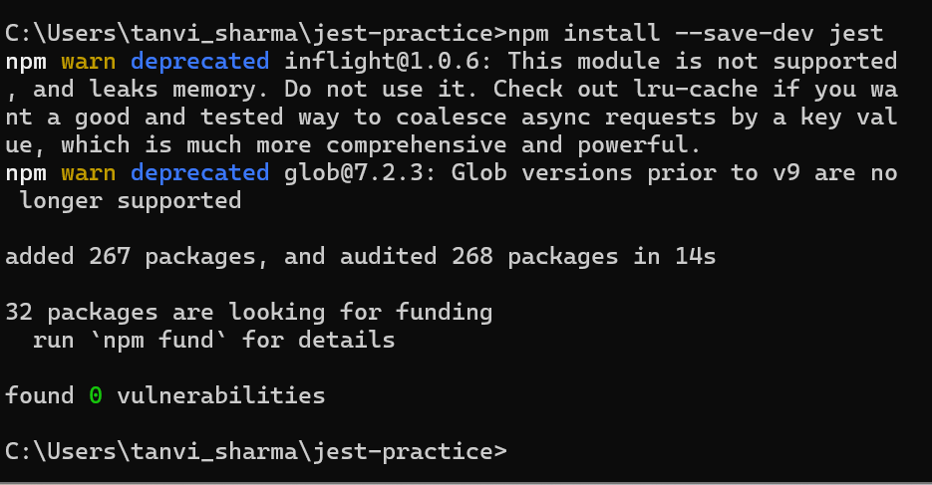

Slide 8
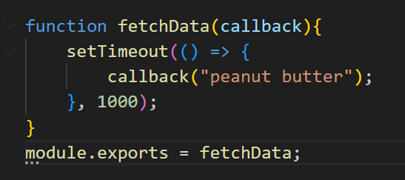
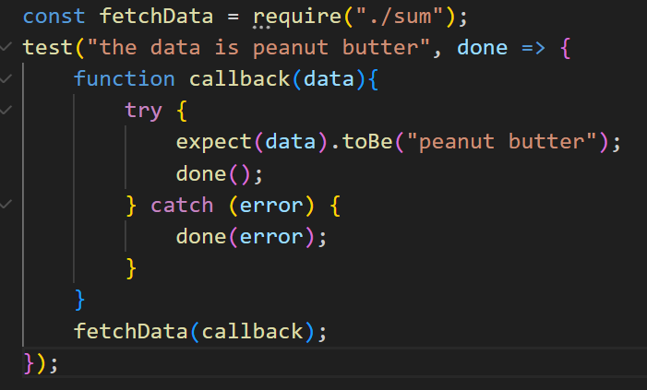
Testing Asynchronous Code
Callback

Slide 9
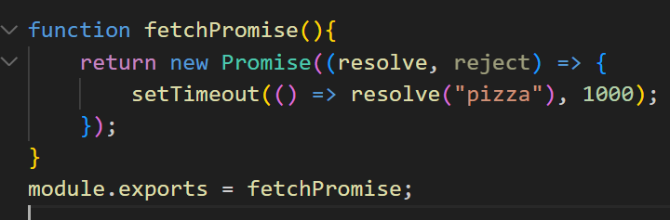
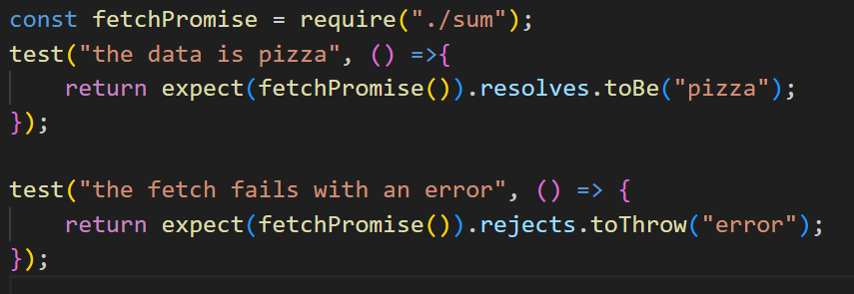
Testing Asynchronous Code
Promise

Slide 10
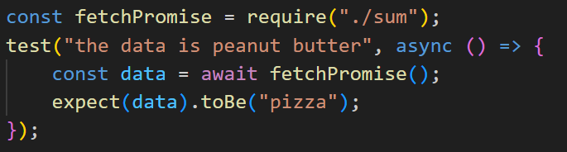
Testing Asynchronous Code
async - await

Slide 11
Summary Of Testing
Matchers
Testing Asynchronous Functions
Mock Functions
Spies

Slide 12

DEBUGGING

Slide 13
Debugging in Javascript
What is Debugging?
The process of finding and fixing errors or bugs in your code.
Common Debugging Tools:
Browser DevTools (Console, Breakpoints, Inspect Element)
VSCode Debugger
Techniques for Debugging:
Use console.log to track code execution.
Leverage breakpoints and step through your code.
Use debugger statement to pause execution.

Slide 14
Debugging with Browser DevTools
Console:
View output, log variables, and check errors.
Breakpoints:
Pause the code at specific points and examine variables.
Call Stack:
Trace the sequence of function calls that led to the current point.

Slide 15
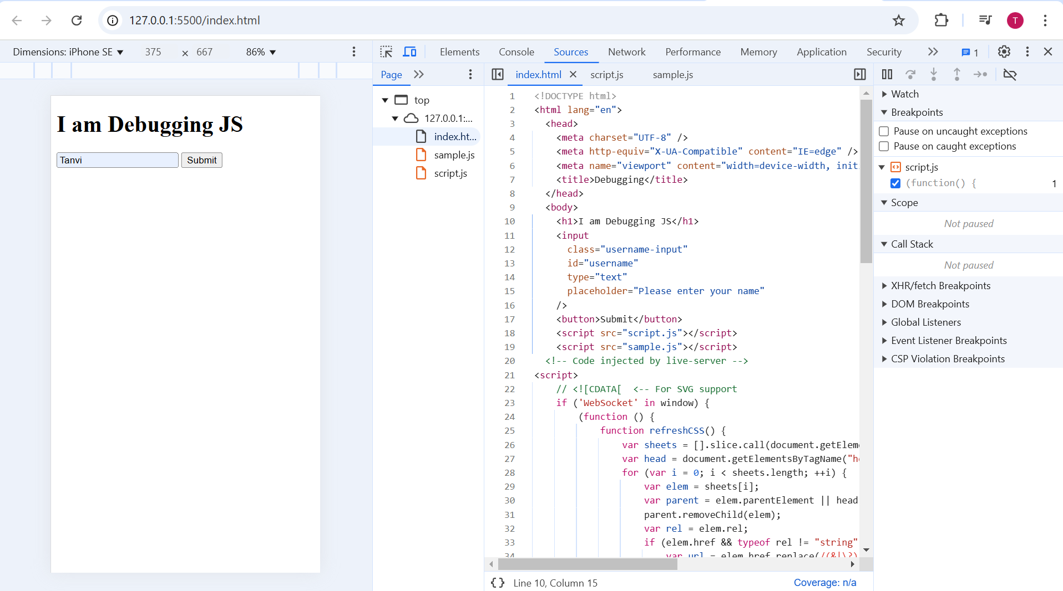
2
1
Code editor
File Navigator
3
Javascript debugger

Slide 16

OPTIMIZATION

Slide 17
Optimization in JavaScript
Why Optimize JavaScript?
To improve performance, responsiveness, and efficiency.
Common Optimization Techniques:
Code Splitting
Lazy Loading
Debouncing and Throttling
Memory Management

Slide 18
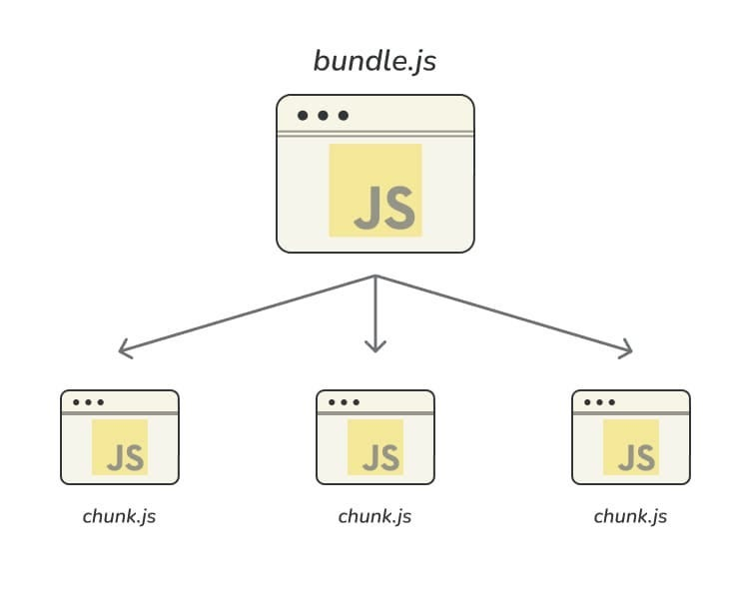
Code Splitting
Code Splitting:
Split code into smaller bundles that load on demand.

Slide 19
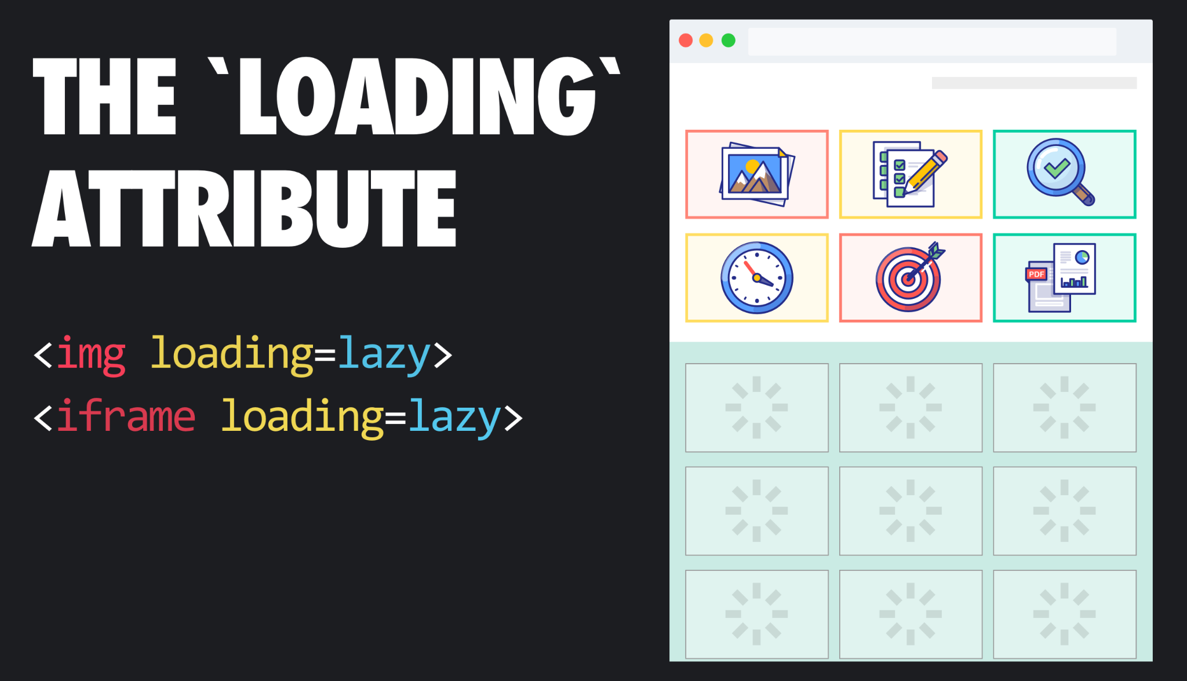
Lazy Loading
Lazy Loading:
Load JavaScript only when needed (e.g., when a user interacts with an element).

Slide 20
Debouncing
Debouncing ensures that a function is only executed after a certain amount of time has passed since the last time the function was triggered. It essentially "delays" the execution of a function until after a specified wait time has elapsed without any further events occurring.

Slide 21
Throttling
Throttling limits the rate at which a function can be called. Unlike debouncing, which waits for the user to stop triggering an event, throttling allows a function to be executed at regular intervals no matter how many times the event is triggered.

Slide 22
Memory Management in JavaScript
Why is Memory Management Important?
Efficient memory usage ensures faster performance and avoids memory leaks.
Techniques:
Use the garbage collector (automatic in JavaScript).
Free up memory by setting variables to null after use.
Avoid circular references.

Slide 23
Best Practices for Optimization
Minimize DOM Manipulation:
Modify the DOM in batches or through virtual DOM libraries like React.
Minimize Network Requests:
Use caching, async loading, and keep API calls minimal.
Avoid Memory Leaks:
Use proper scoping, clean up event listeners, and avoid global variables.

Slide 24

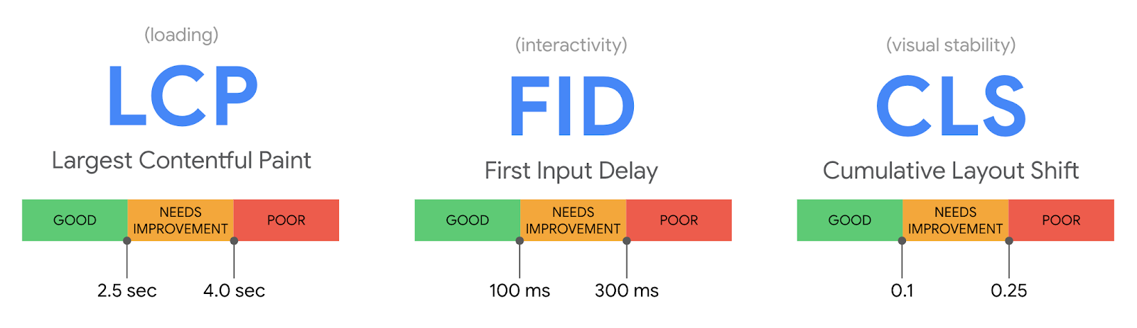
Tools for Performance Monitoring
Google Chrome Lighthouse:
Audits performance, accessibility, and SEO.
Performance API:
Measures execution times and frame rendering.
Web Vitals:
Measures user experience metrics.

Slide 25

SECURITY

Slide 26
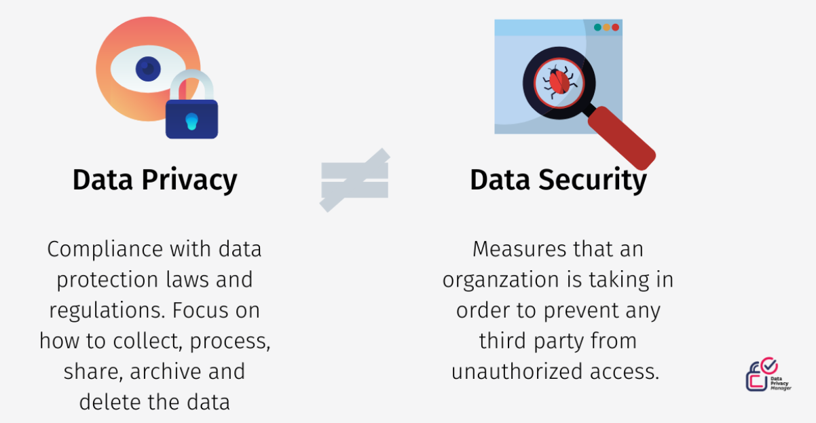
Security vs Privacy

Slide 27
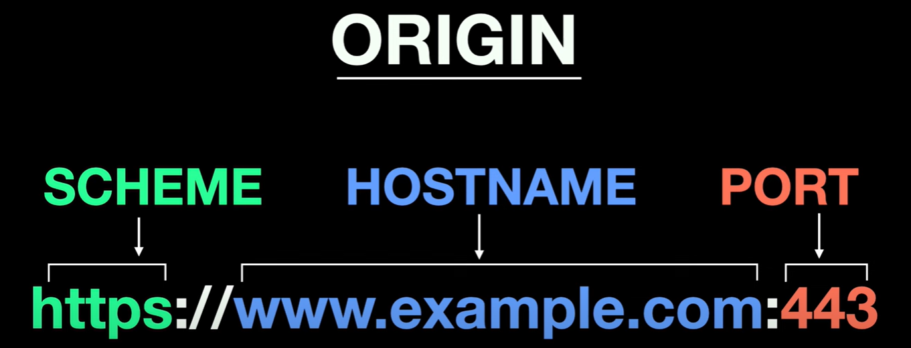
Same-Origin Policy

Slide 28
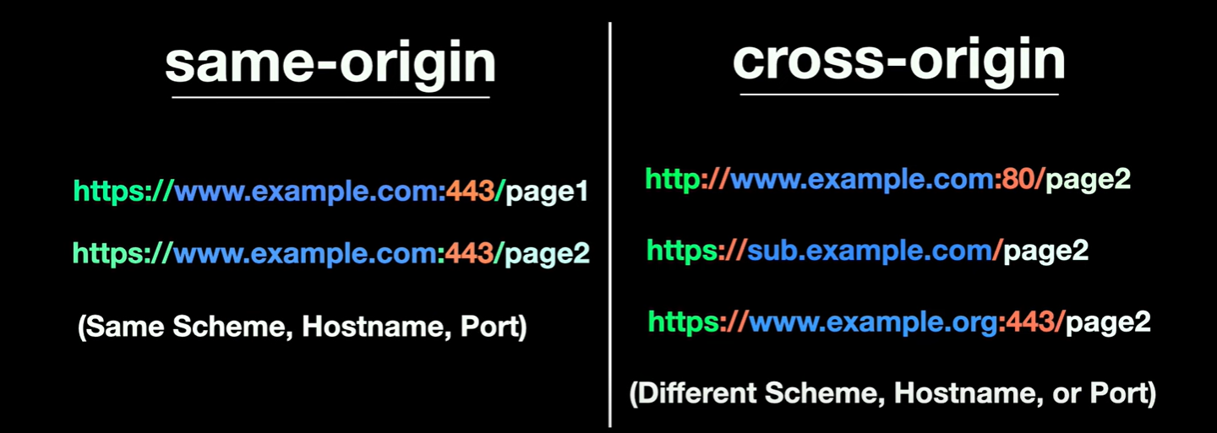
Same-Origin Policy

Slide 29
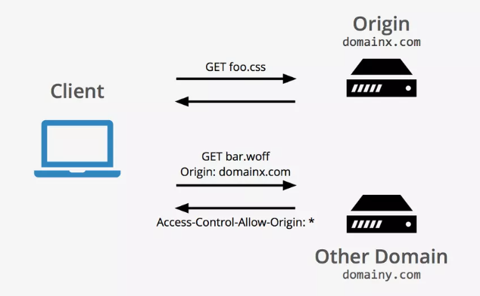
Cross Origin Resource Sharing - CORS

Slide 30
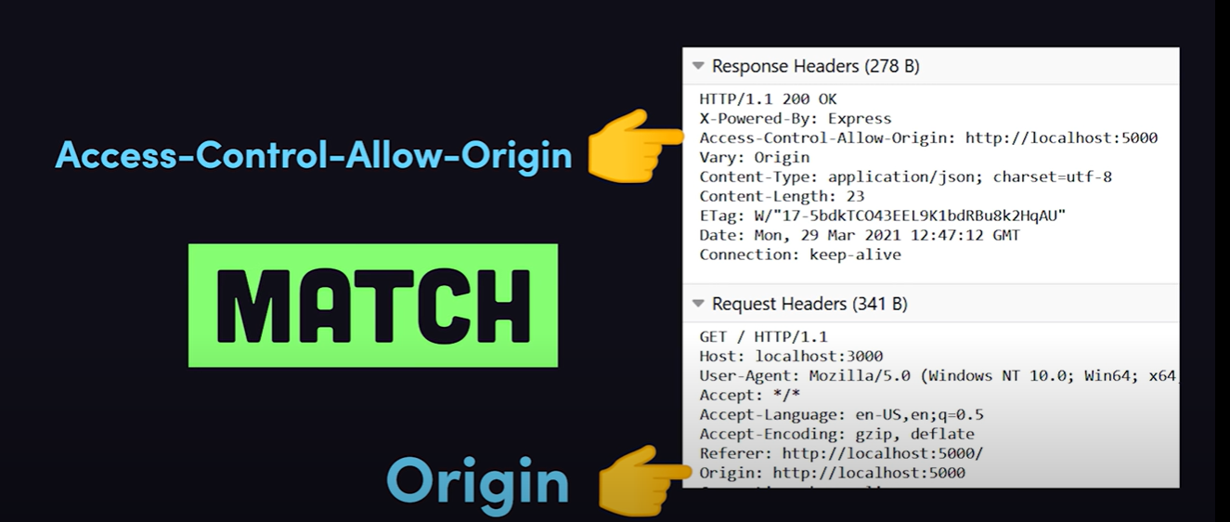

Slide 31

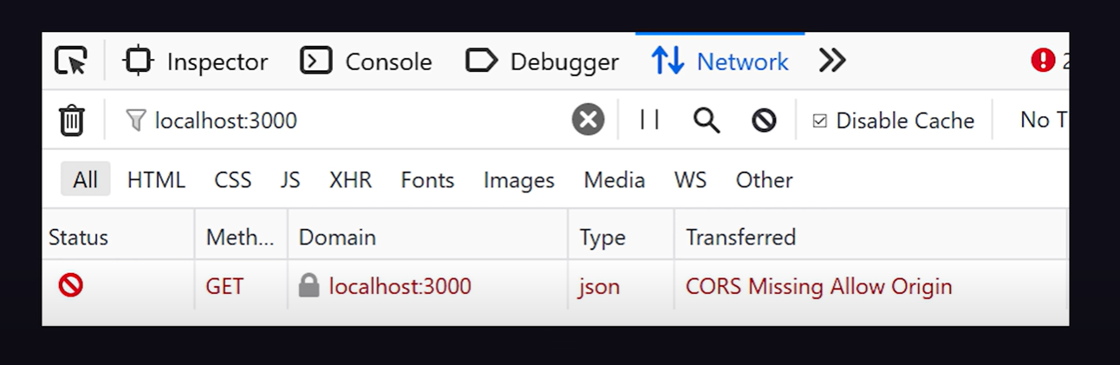

Slide 32
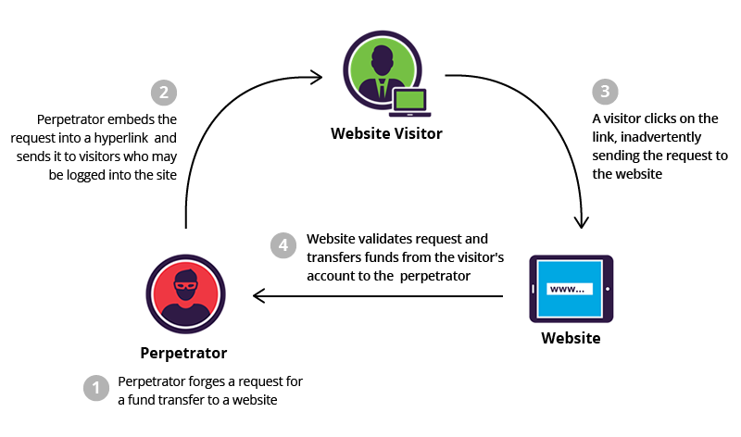

Cross Site Request Forgery Attack - CSRF Attack

Slide 33
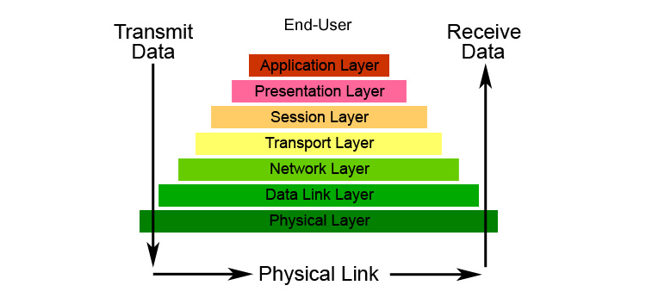
Transport Layer Security
Certificate based Authentication
Forward Secrecy
TLS Handshake Protocol

Slide 34
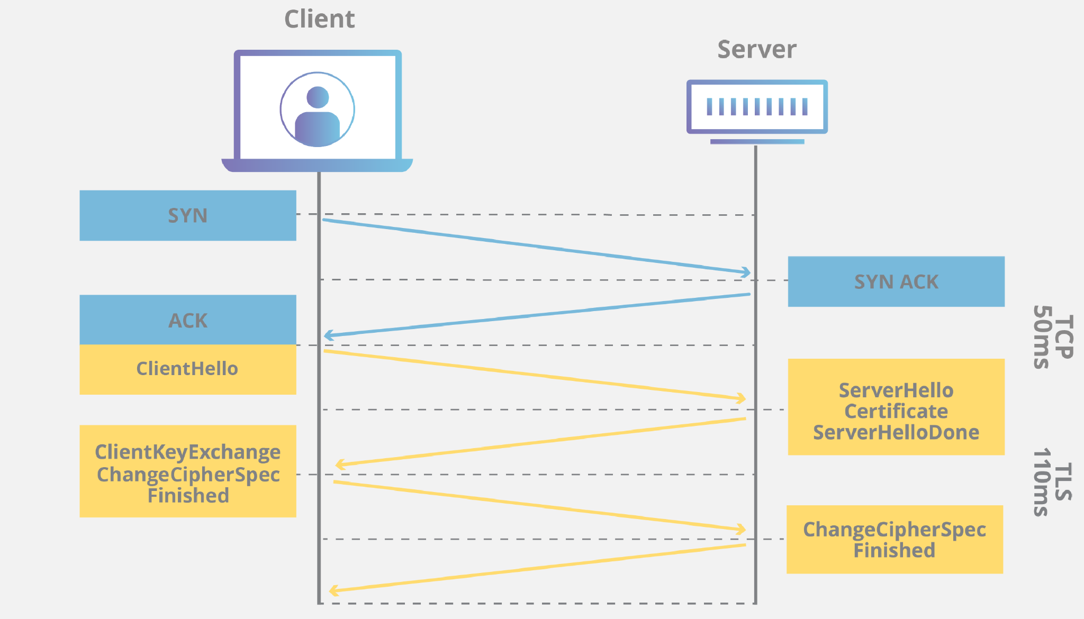
TLS - 3 Way Handshake

Slide 35
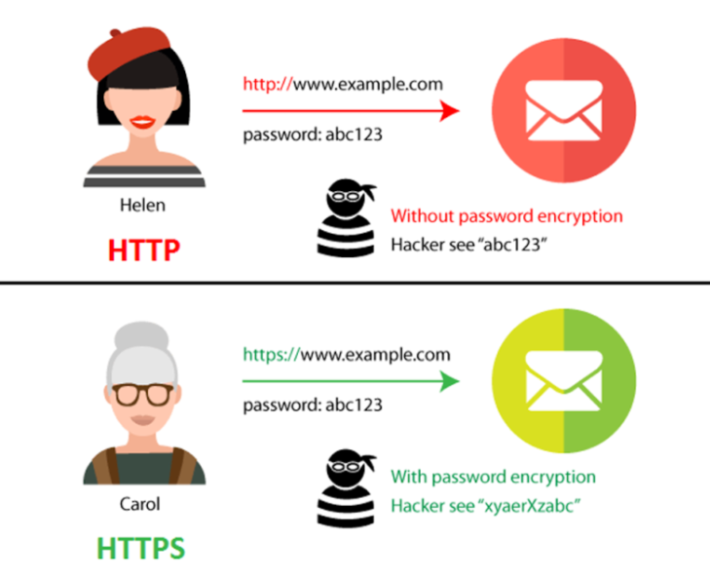
HTTP
vs
HTTPS

Slide 36
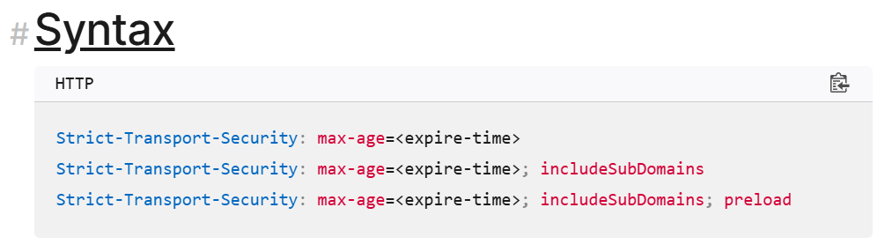
Strict-Transport-Security
The HTTP Strict-Transport-Security response header (often abbreviated as HSTS) informs browsers that the site should only be accessed using HTTPS, and that any future attempts to access it using HTTP should automatically be upgraded to HTTPS.

Slide 37
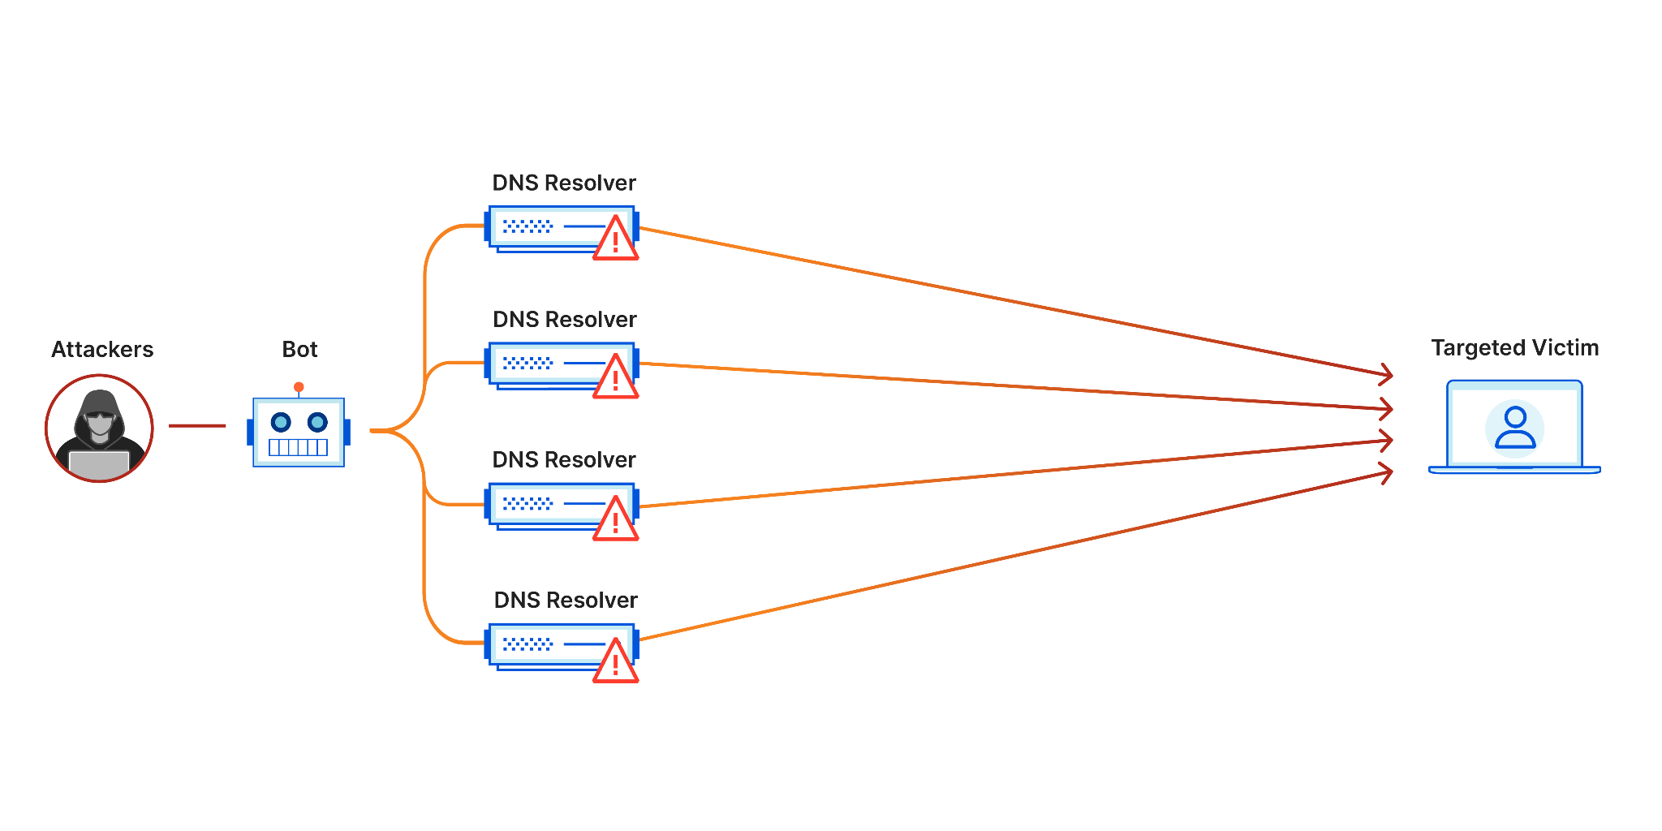
Denial Of Service Attack - DoS

Slide 38
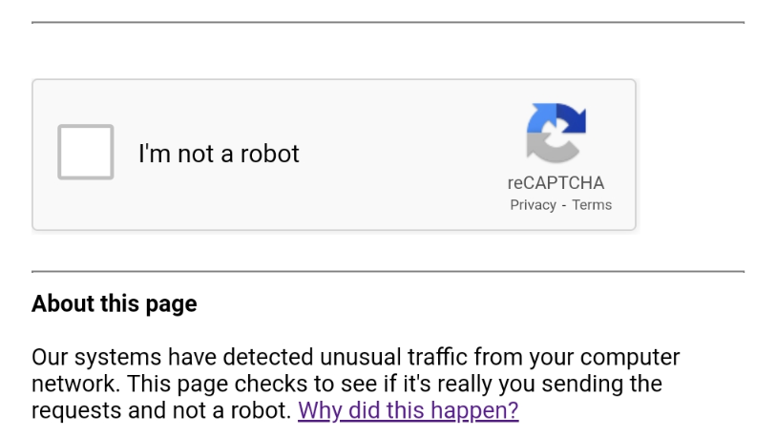
Interesting Fact

Slide 39
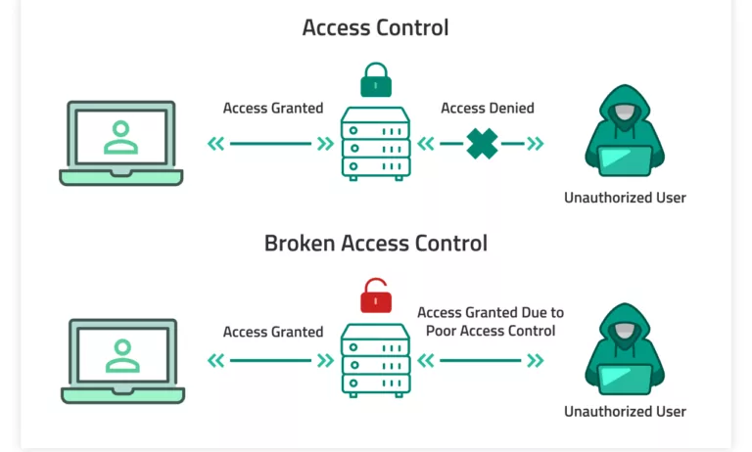
Broken Access Control Vulnerability

Slide 40
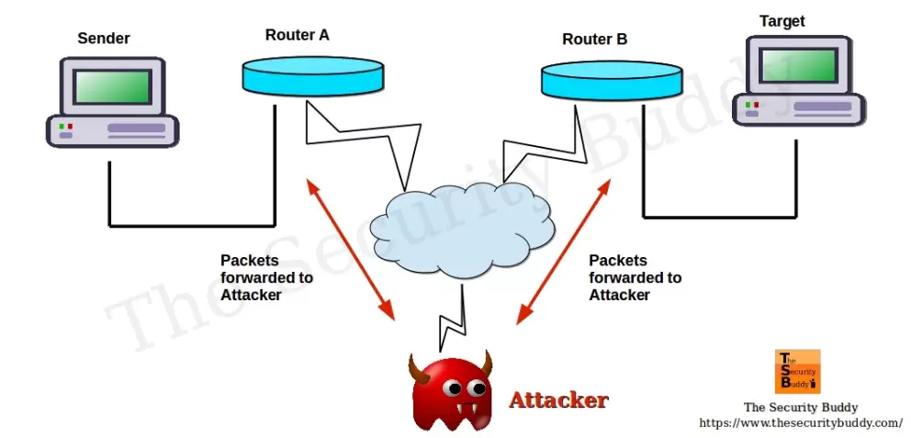
Man-in-the-Middle Attack

Slide 41
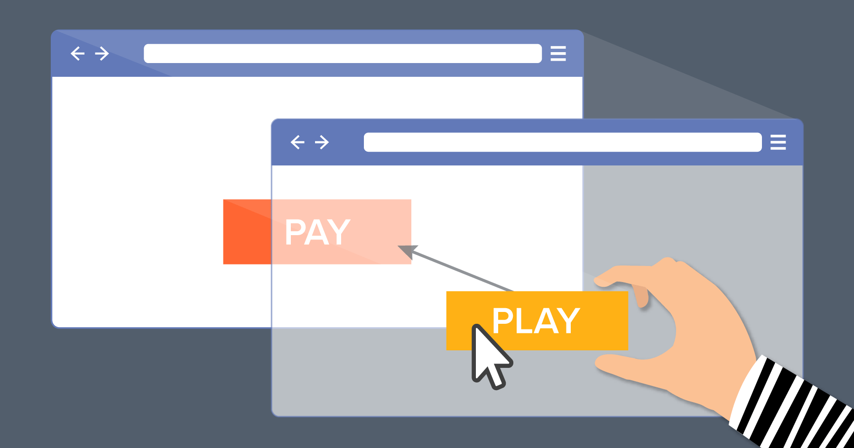
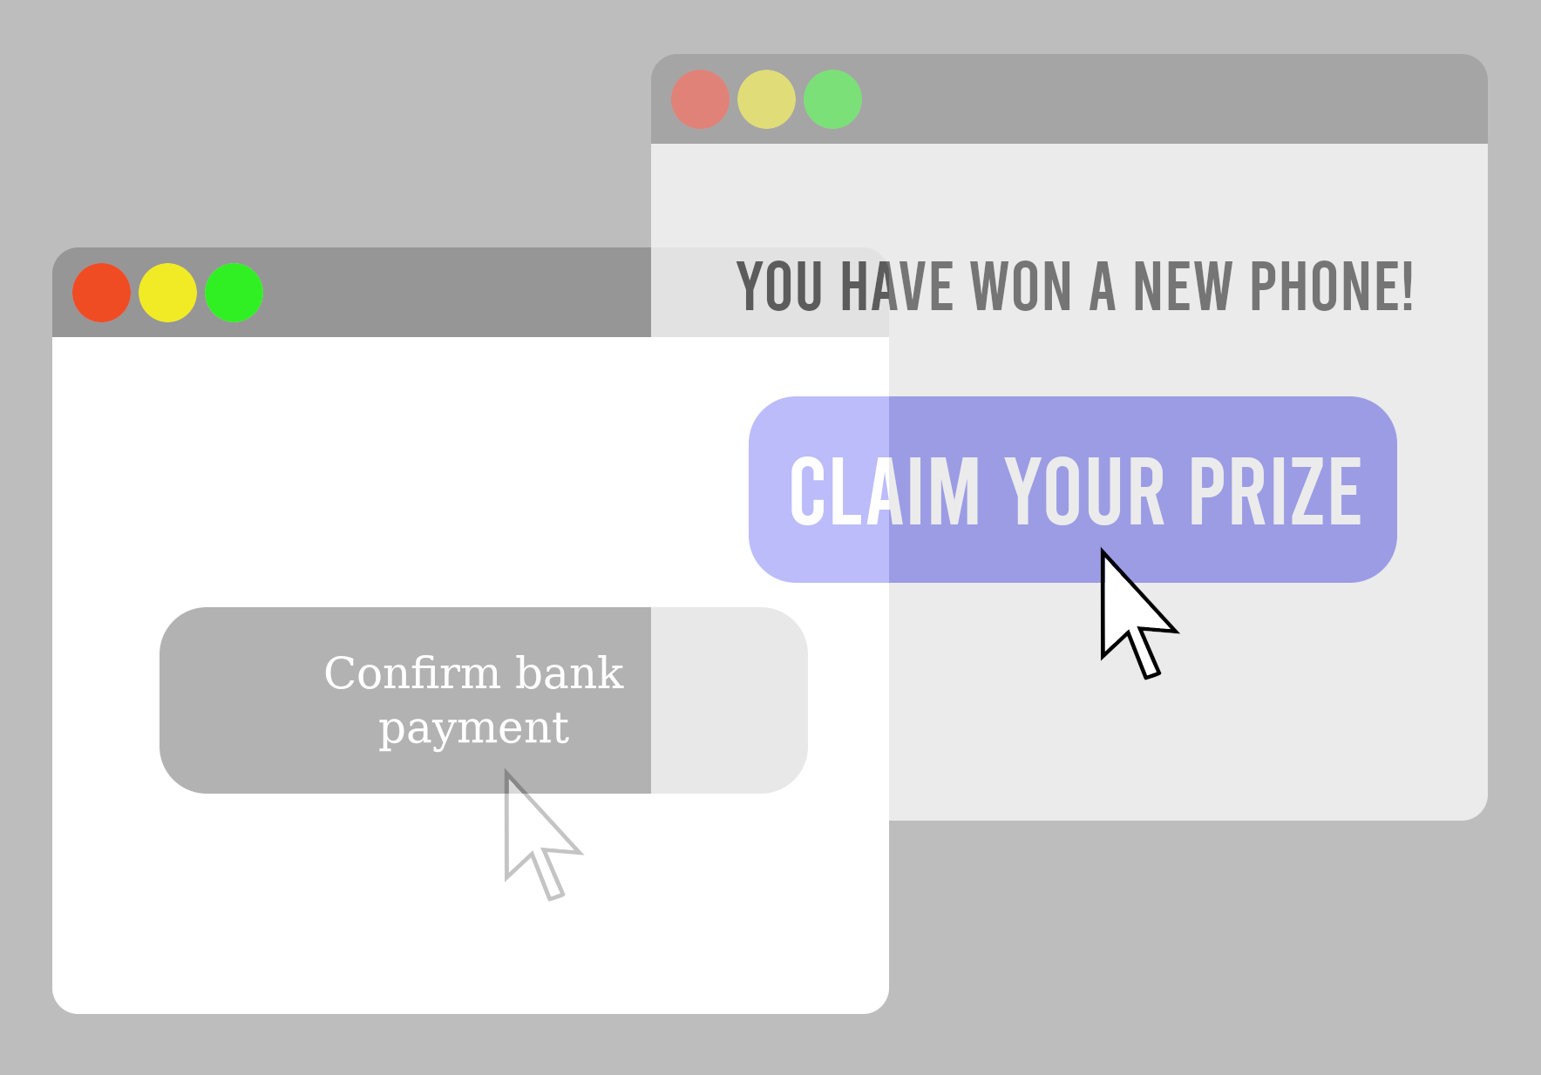
Clickjacking Attack

Slide 42
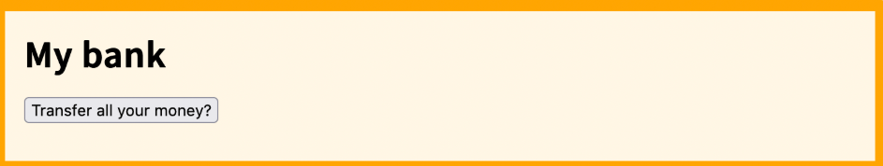
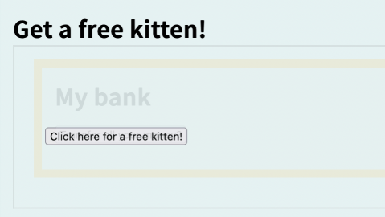
HTML :
<button id="fake-button">Click here for a free kitten!</button>
<iframe width="800" height="200" src="https://my-bank.example.com"></iframe>
CSS :
iframe {
opacity: 0;
}
#fake-button {
position: absolute;
top: 185px;
left: 90px;
}

Slide 43
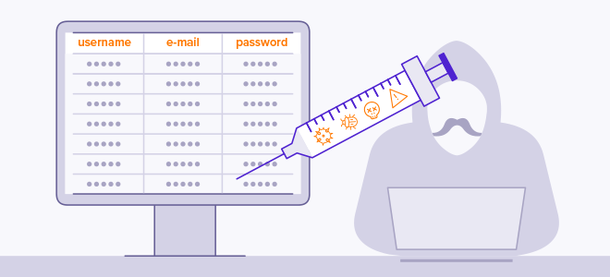
SQL Injection Attack

Slide 44
SQL Injection Attack
SQL:
SELECT * FROM users WHERE name = 'a';DROP TABLE users; SELECT * FROM userinfo WHERE 't' = 't';
SQL:
SELECT * FROM users WHERE name = ? AND password = ?;
/* name and password are passed as parameters */

Slide 45

Did you hear about the cybercriminal who got away?
They ransomware!

